Slide 1
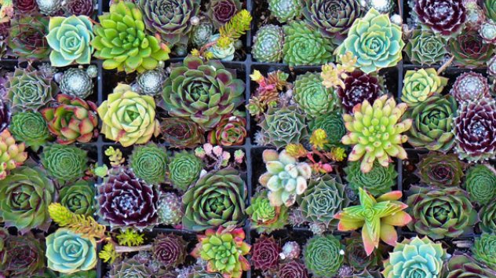
HORTIHUB.COM
Where a simple search can give you a green thumb. ^_^

Slide 2

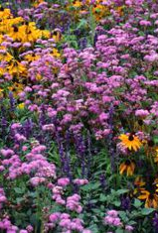
Motivation
Our main motivation for our app was to create a website where the user can retrieve data on any plant.

Slide 3
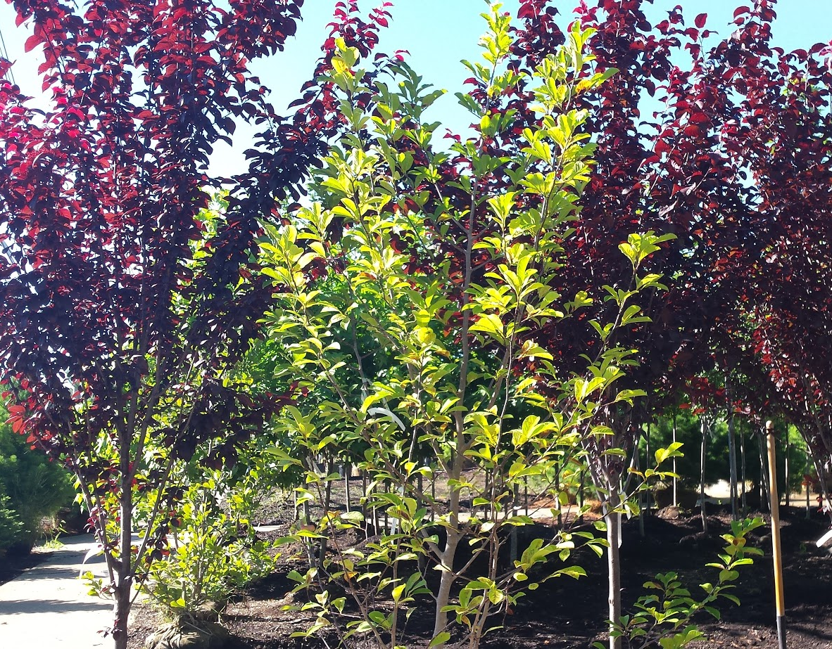
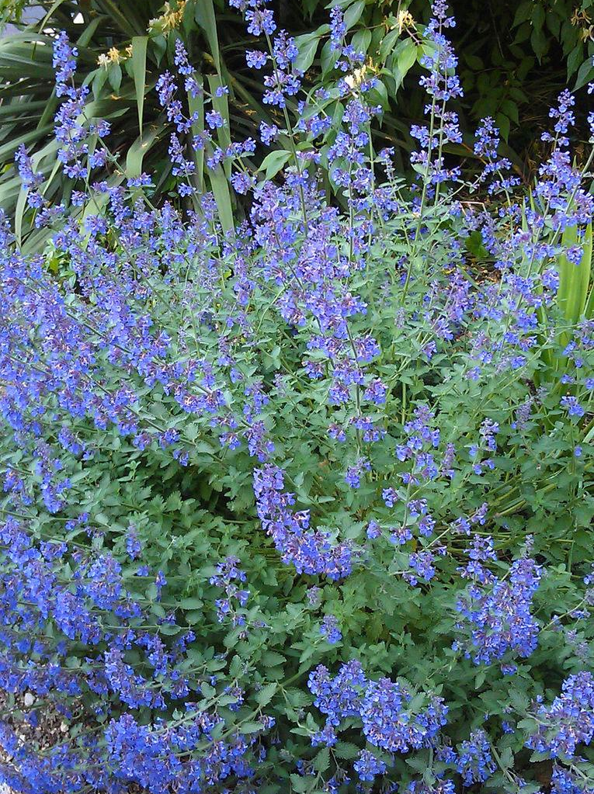
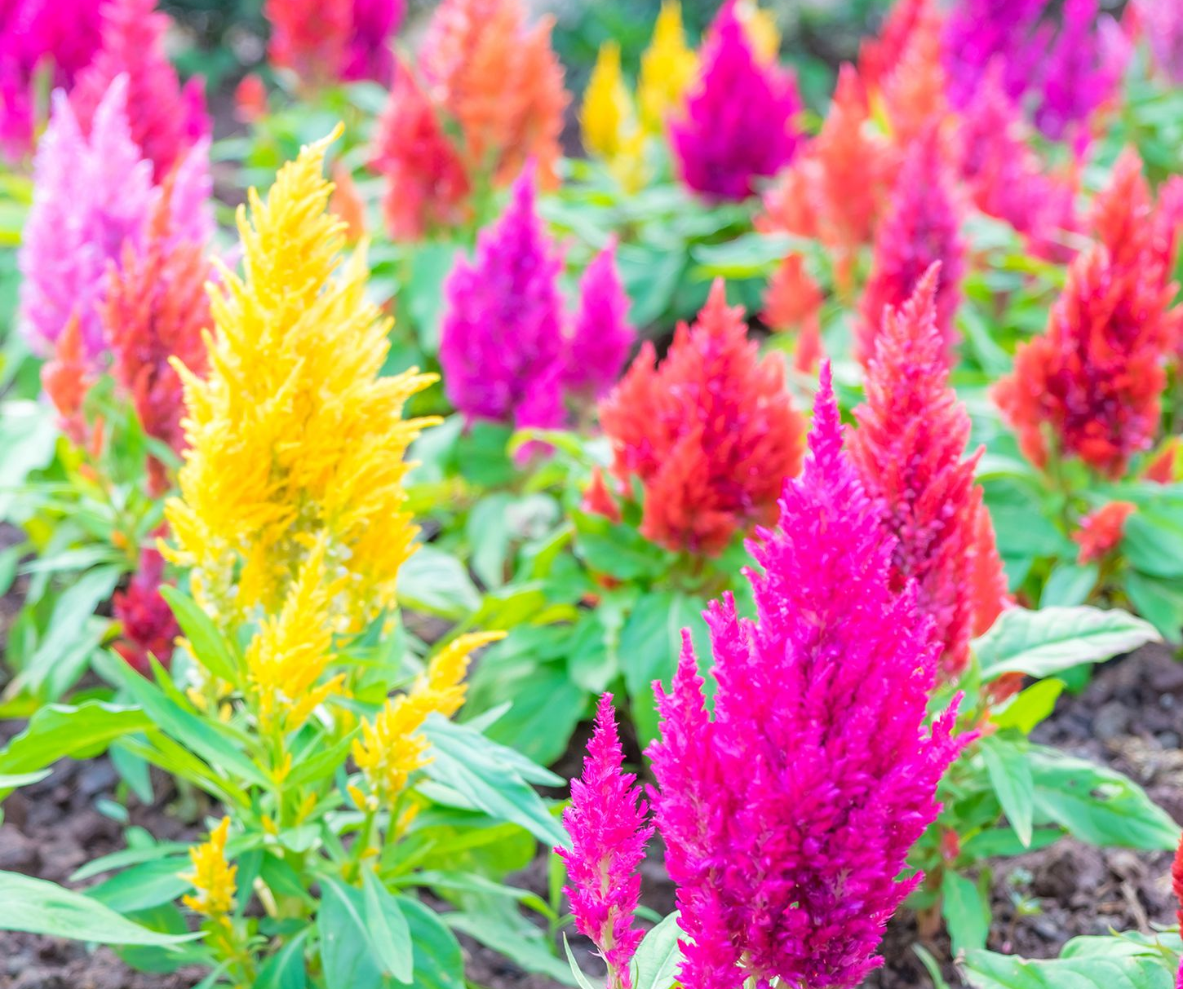
Concept
The user may use this data to properly care for any plant that they may desire to grow.​
The user may save these plants and have the app show them the lifespan and when the user should water it next.

Slide 4
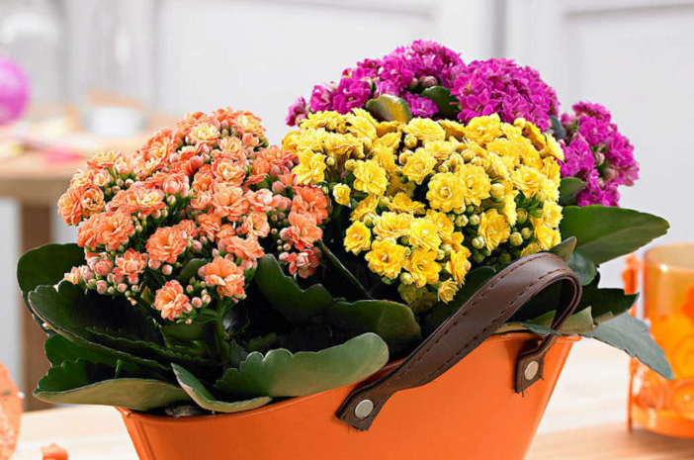
Design
Use an express server to handle routing and requests.
Use sequelize to interact with the database.
Use MySQL relational database to store the data with encrypted user info.
Stored on a AWS EC2 instance in an S3 bucket using Elastic Beanstalk.
Used Trefle api to get plant information.

Slide 5






Technologies
AWS
Trefle
Node & Express
Cookie Parser
MySQL
Sequelize
HTML, CSS & Javascript using WebFlow
Trefle API

Slide 6
Future Development
Add more detailed information on watering and sunlight needs and other care related aspects.
Add Google Alerts to alert the user when the plants need watering.
Add working Express Sessions to increase security.
Add more animations so the website is more interactive.

Slide 7

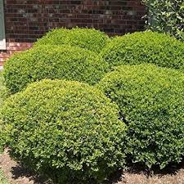
THANK YOU FOR YOUR TIME!

